Slide 1
Flight Price Prediction
Submitted by
Tushar Kumar Patel

Slide 2
Project analysis slide 2
Project Analysis
Inrtoduction
Visualization
Flight Price Prediction
Dataset and Features
Model
Processing
Conclusion

Slide 3
Introduction
Anyone who has booked a flight ticket knows how unexpectedly the prices vary. The cheapest available ticket on a given flight gets more and less expensive over time. This usually happens as an attempt to maximize revenue based on -
1. Time of purchase patterns (making sure last-minute purchases are expensive)
2. Keeping the flight as full as they want it (raising prices on a flight which is filling up in order to reduce sales and hold back inventory for those expensive last-minute expensive purchases)
Initially the collection of the data of flight ticket price has been scrapped using selenium.

Slide 4
CONCEPTUAL BACKGROUND OF THE DOMAIN PROBLEM
In this section we have to scrape the data of flights from different websites (yatra.com, skyscanner.com, official websites of airlines, etc). The number of columns for data doesn’t have limit, it’s up to you and your creativity. Generally, these columns are airline name, date of journey, source, destination, route, departure time, arrival time, duration, total stops and the target variable price. You can make changes to it, you can add or you can remove some columns, it completely depends on the website from which you are fetching the data.
Airline companies use complex algorithms to calculate flight prices given various conditions present at that particular time. These methods take financial, marketing, and various social factors into account to predict flight prices. Nowadays, the number of people using flights has increased significantly. It is difficult for airlines to maintain prices since prices change dynamically due to different conditions. That’s why we will try to use machine learning to solve this problem. This can help airlines by predicting what prices they can maintain. It can also help customers to predict future flight prices and plan their journey accordingly

Slide 5
Data Set Description
Features:
Name: name of Airline
Date: date of journey
Dtime: time of departure
Atime: time of arrival
From: the source from which service begins
To: the destination where service ends
Stops: total number of stops between source and destination
Price: Price of flight ticket
The dataset has no null values.

Slide 6
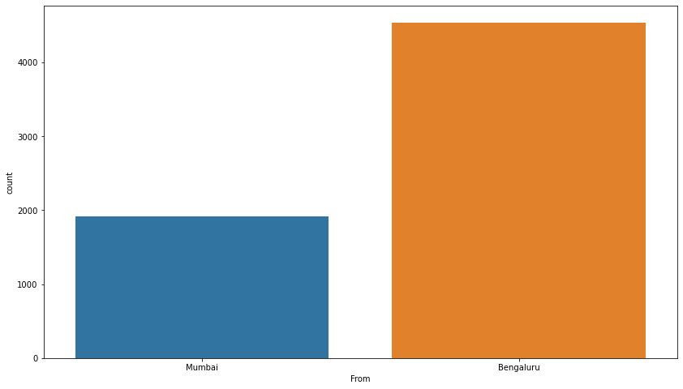
Visualization
Flight Origin

Slide 7
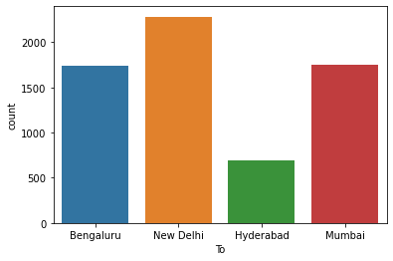
The destination of the flight is Bengaluru, New Delhi, Hyderbad and Mumbai.
The number of flight leaving Delhi is more than Bengaluru, Mumbai and Hyderabad.

Slide 8
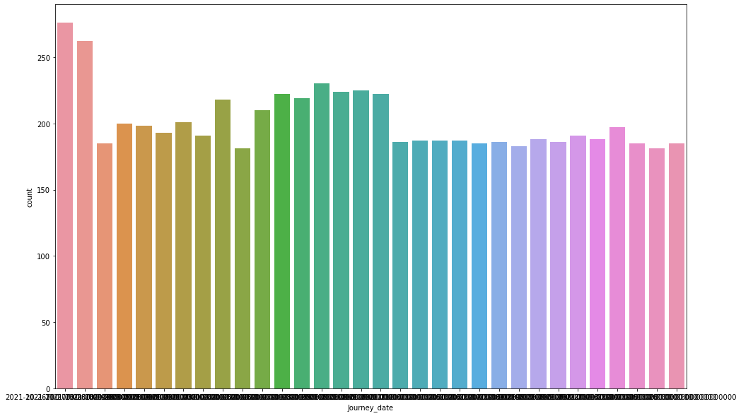
Journey date

Slide 9
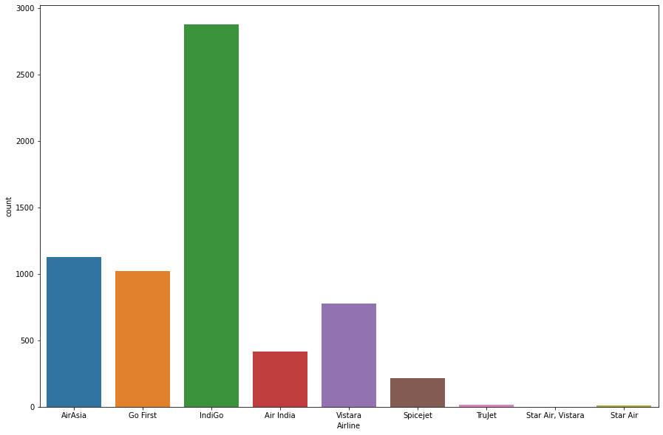
Name of Airline
The operation of filght from one place to another place is more by Indigo than any other flight.
Indigo 2876
AirAsia 1128
Go First 1021
Vistara 778
Spicejet 213
Trujet 13
Star Air 11
Star Air, Vistara 1

Slide 10
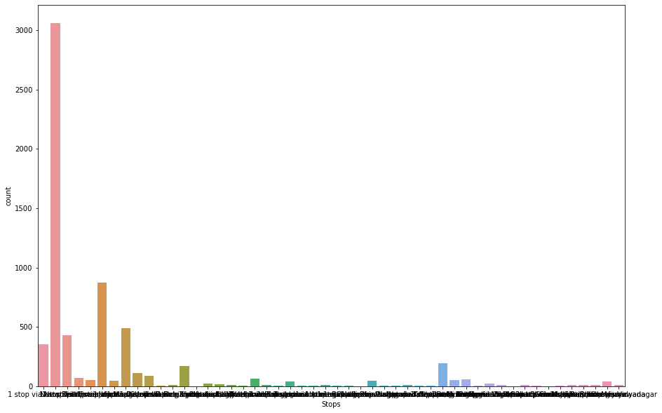
Total number of stops.
The total number for 1 stops is 3338 which is more than 50% than any other number of stops.

Slide 11
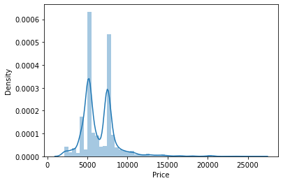
Fare of flight ticket.
The maximum price for the flight ticket is more than 25000.
The price of flight ticket lies between 2500 to 10000 is more.

Slide 12
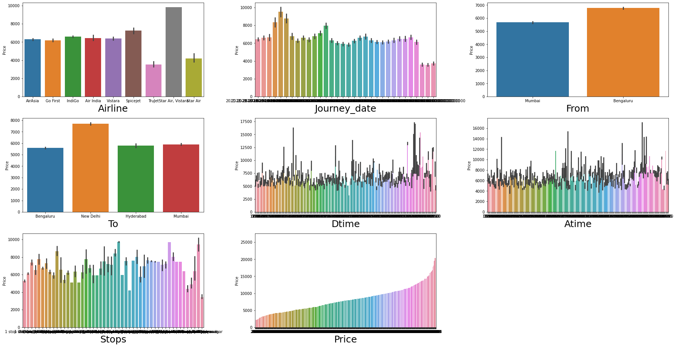
Comparison of all features with Price.

Slide 13
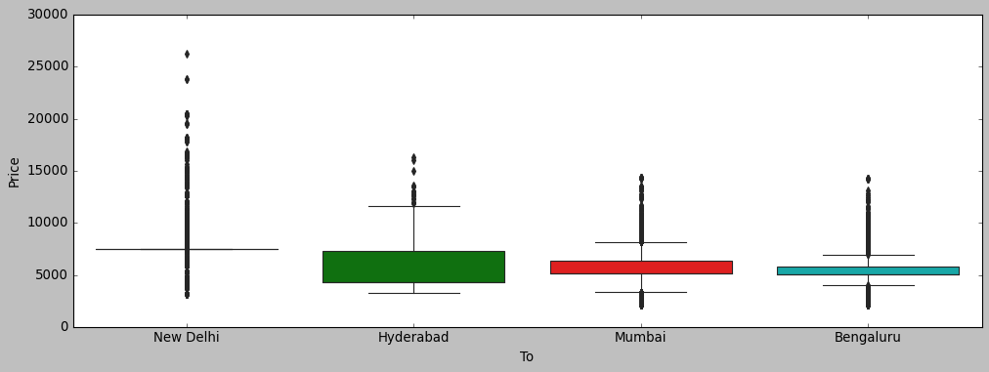
Comparison of Price with Departure

Slide 14
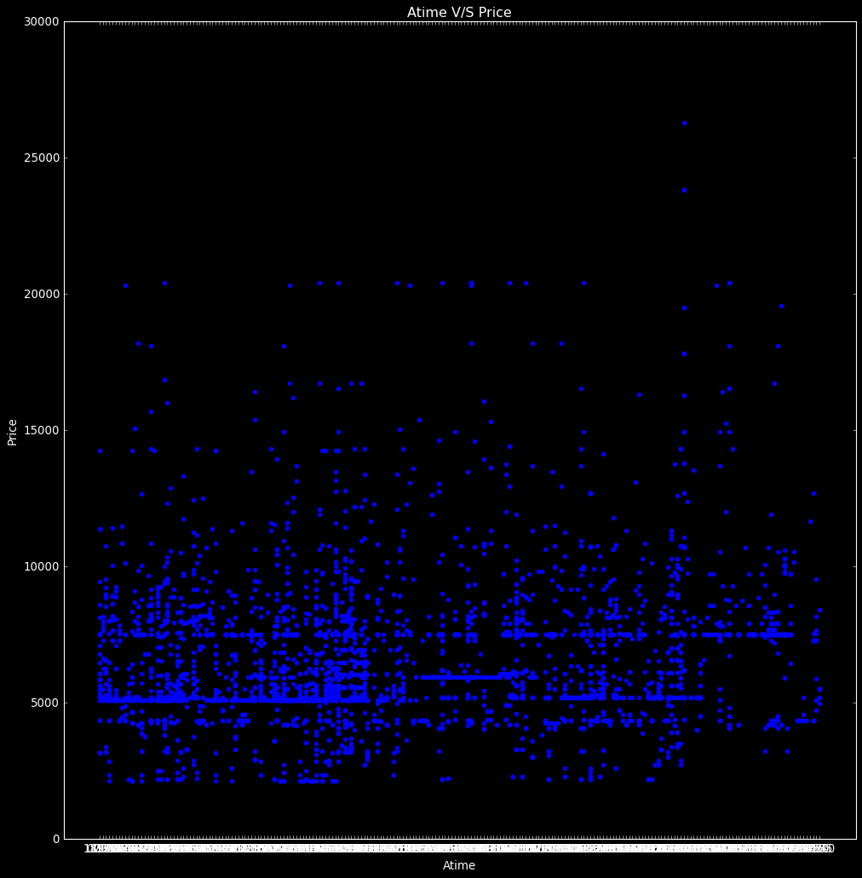
Comparison of Arival time vs Price.

Slide 15
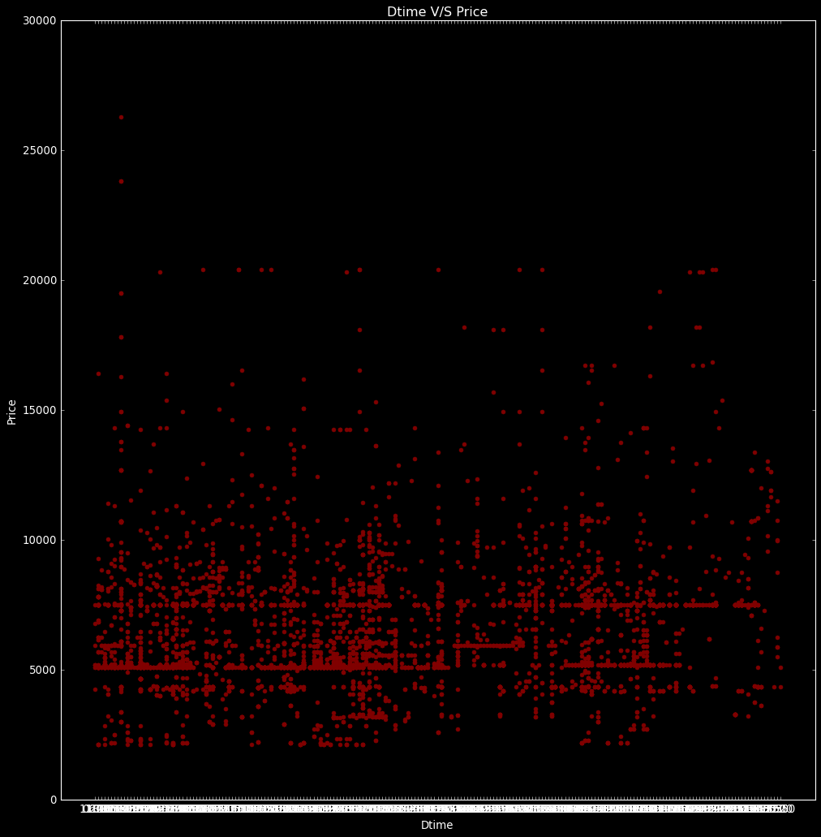
Comparison of Departure time vs Price

Slide 16
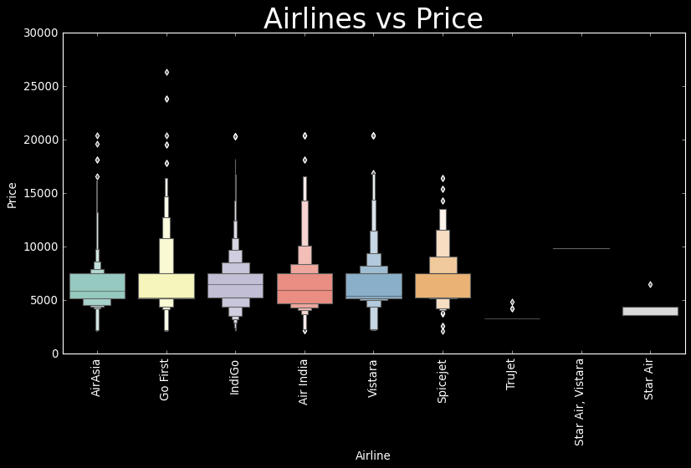
Comparison between Airline and price

Slide 17
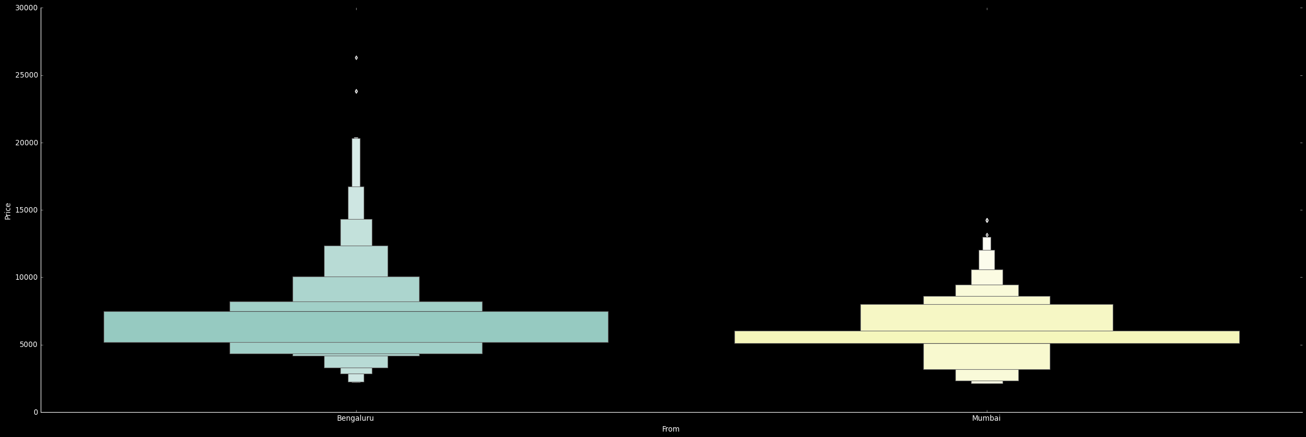
Comparison between Source and price

Slide 18
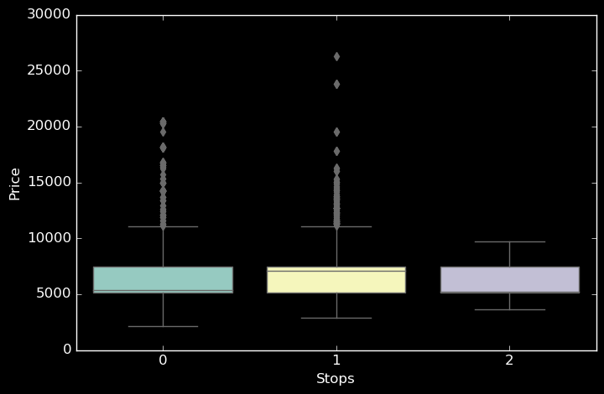
Comparison between Price and Number of stop

Slide 19
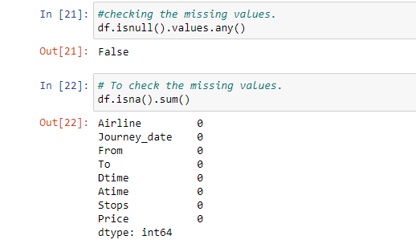
Data Processing.
In this data there is no missing values.
To check the missing values we use the command.

Slide 20
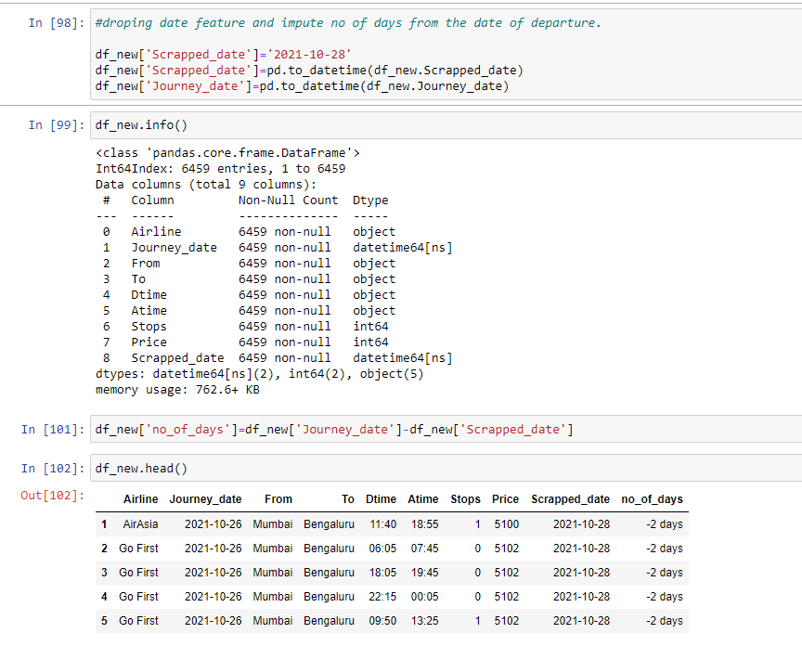

Slide 21
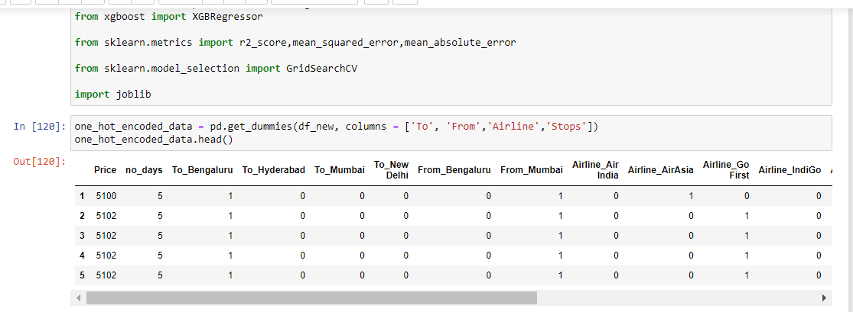
One Hot Encoder

Slide 22
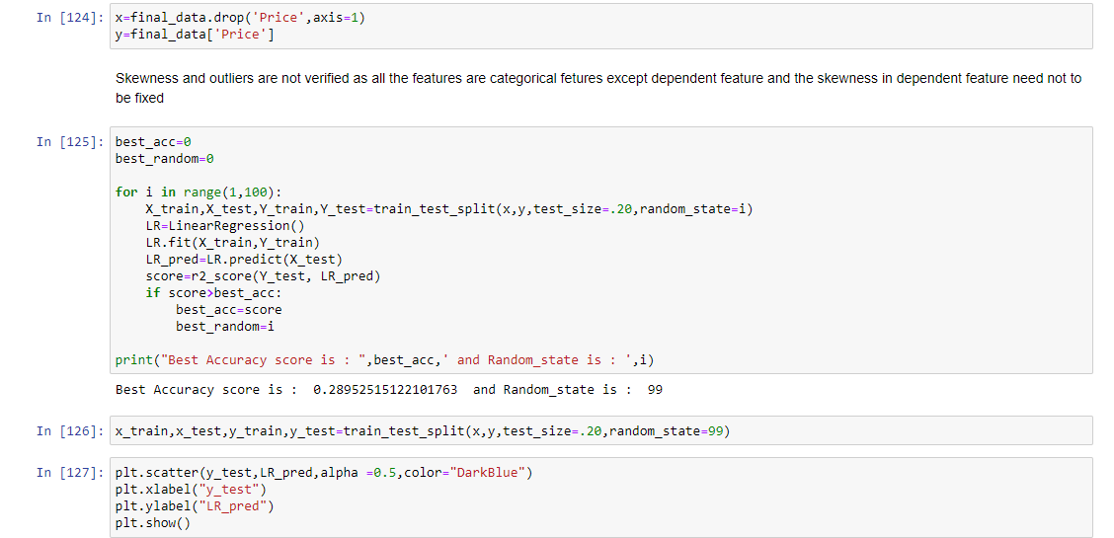
Model Building

Slide 23
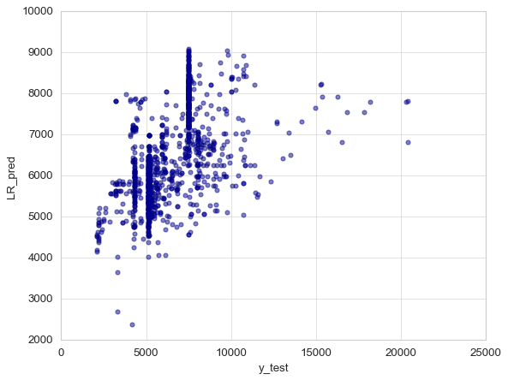
Variation of Prices in prediction result of Linear Regression.

Slide 24
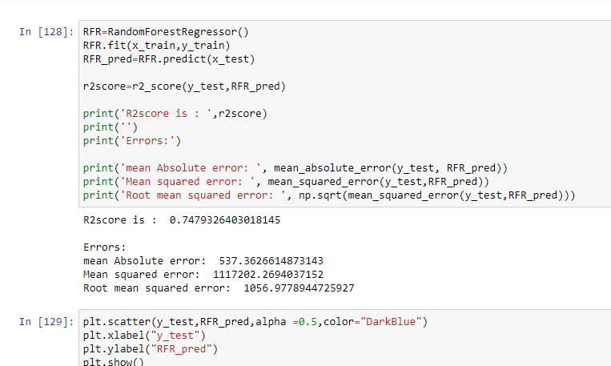

Slide 25
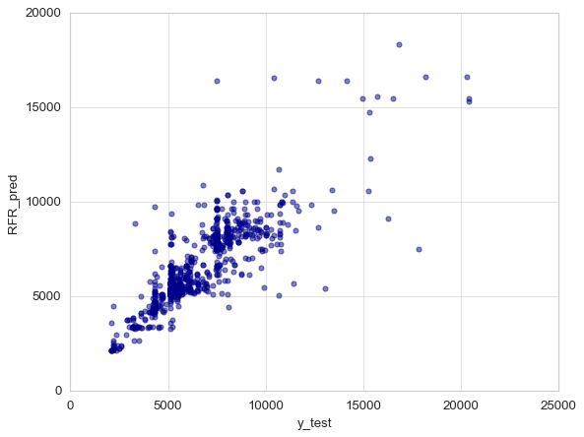
Prediction result of Random Forest Regressor.

Slide 26
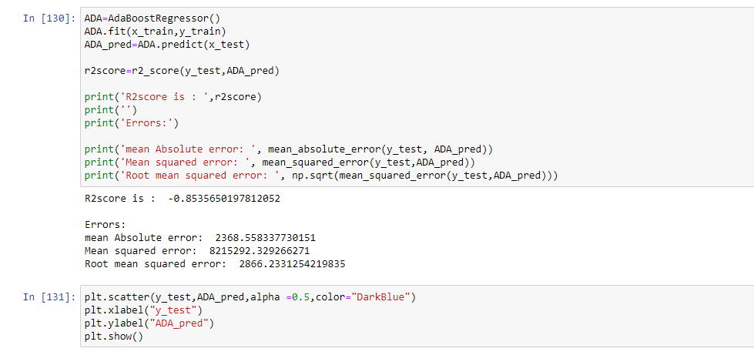

Slide 27
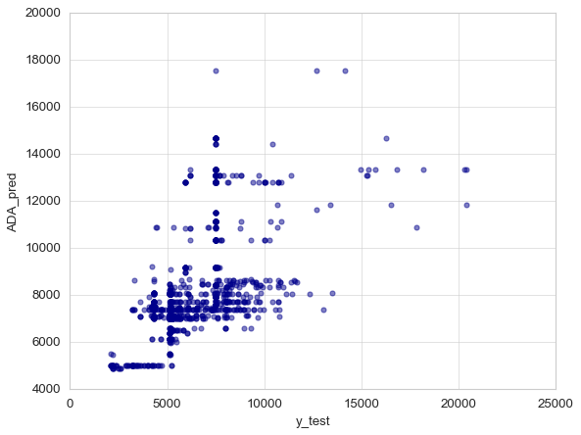
Prediction result of AdaBoost Regressor

Slide 28
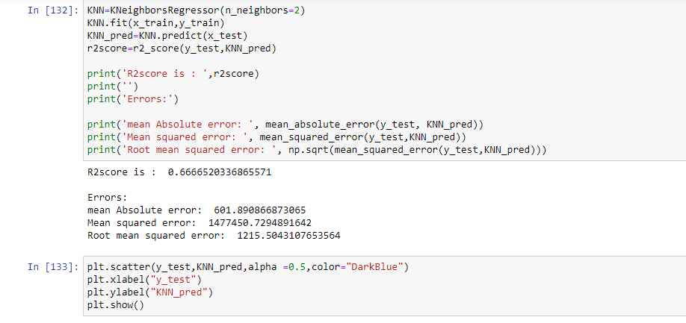

Slide 29

Prediction Result of K-NN

Slide 30
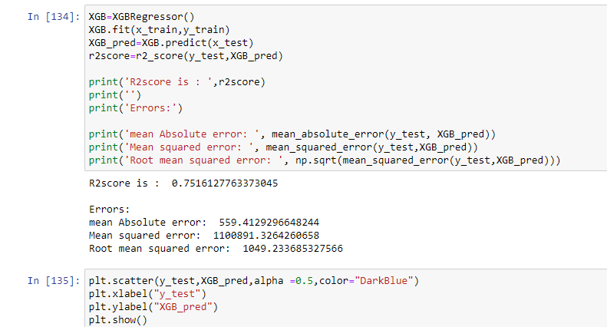

Slide 31

Prediction result of XG Boost

Slide 32
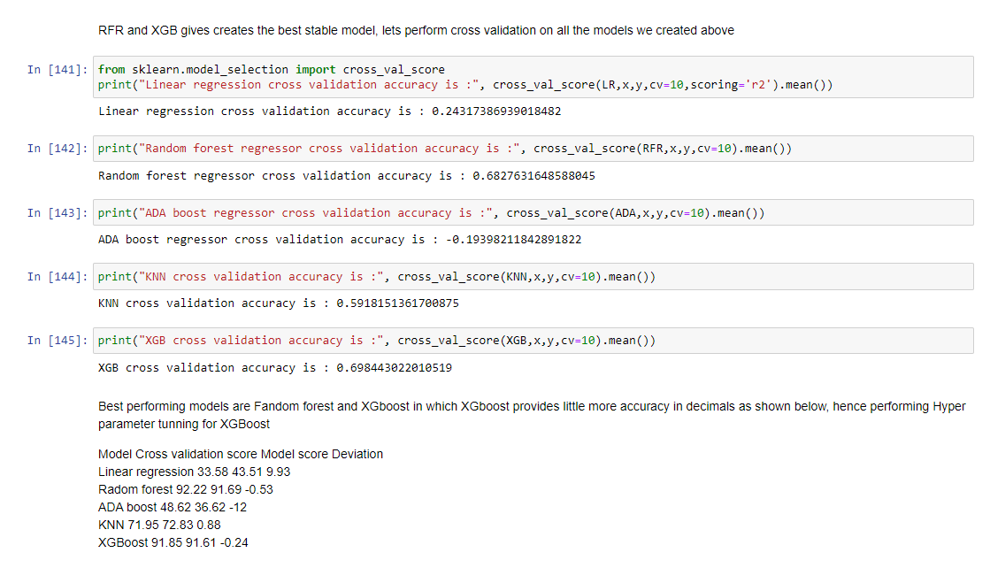
Cross validation

Slide 33
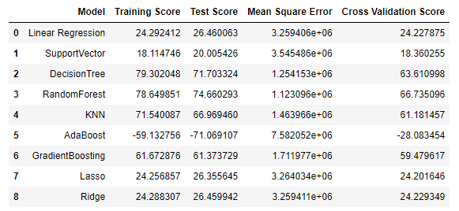
Table of training score, test score, MSE and Cross validation.

Slide 34
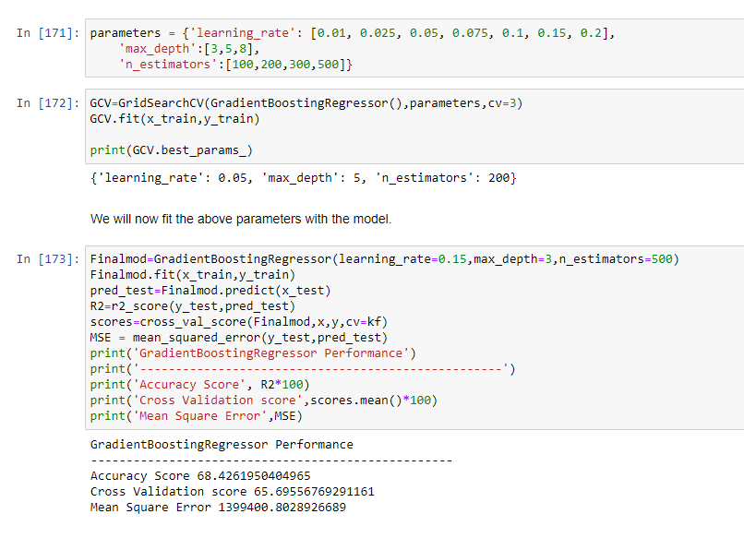
Hyper-parameter tuning.

Slide 35
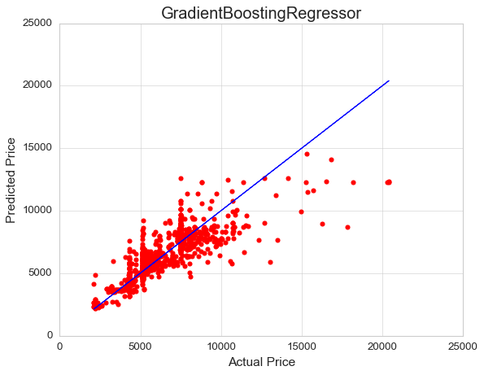
Prediction result after hyperparameter tuning.

Slide 36
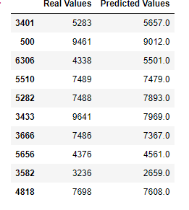
Comparison between Real value and Predicted value

Slide 37
Conclusion
After performing EDA in this project we observed:
Flights from Bangalore and Mumbai have higher prices.
Flights with longer route i.e. high number of stops have high prices.
Also, prices of flight in next month are high as compared to those in coming months.
From the given data we can also conclude that StarAir and Spicejet flights are expensive as compared to other flights.
The model build after hyper-parametric tuning gives an accuracy for 68%

Slide 38
Thank You

